Slide 1
Capstone Project 2
Supervised ML - regression
Bike sharing demand prediction
by
Amit . S. kashyap

Slide 2
Problem statement:
Currently Rental bikes are introduced in many urban cities for the enhancement of mobility comfort. It is important to make the rental bike available and accessible to the public at the right time as it lessens the waiting time.
This prior knowledge of knowing the bike demand at the right time is crucial for bike rental companies in the city of Seoul.
Our main aim here is to solve this problem and predict the bike demand across different hours and also various other inputs which are related to the weather conditions of the city.

Slide 3
Understanding our data:
The dataset that we are working with contains 8,760 observations and 14 columns.
Each observation includes information about the bikes rented and the weather for a particular hour of a particular date.
The 14 columns represent different ﬁelds. We will understand each column now.

Slide 4
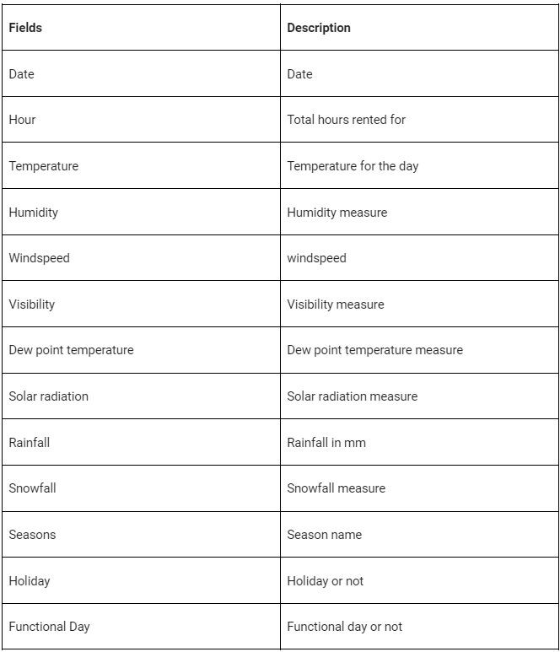
The columns involved:

Slide 5
Project Flowchart:
Import library.
EDA.
Data cleaning.
Feature Engineering.
Pre processing the data.
Model
implementation.

Slide 6
1. Import library:
In this section I’ve loaded in the dependencies, like pandas, seaborn, and many more from the scikit learn library.
The next step was to mount the drive where the data was stored.
After mounting the drive I used the pandas.read_csv() function to read the data given to us in csv format.

Slide 7
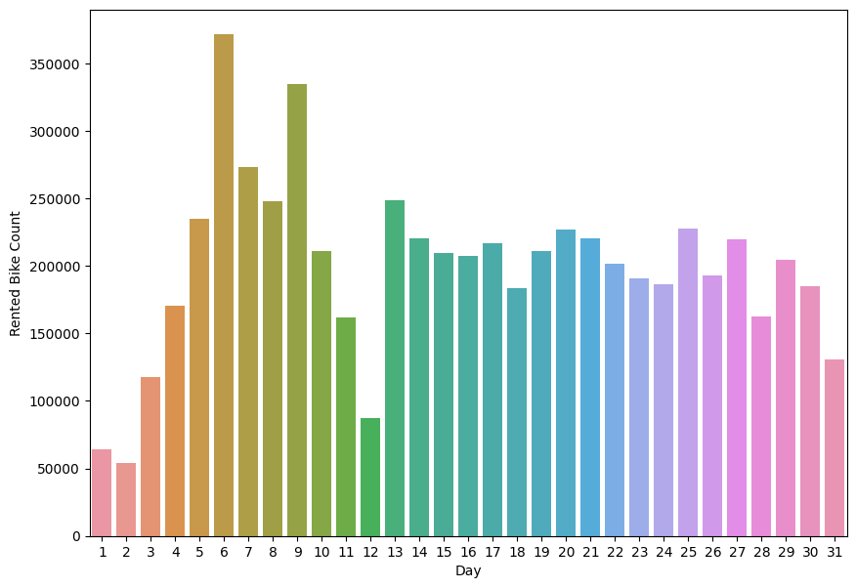
2. EDA:
I have produced visualizations by plotting all the columns individually against the target column (i.e. Rented Bike Count)

Slide 8
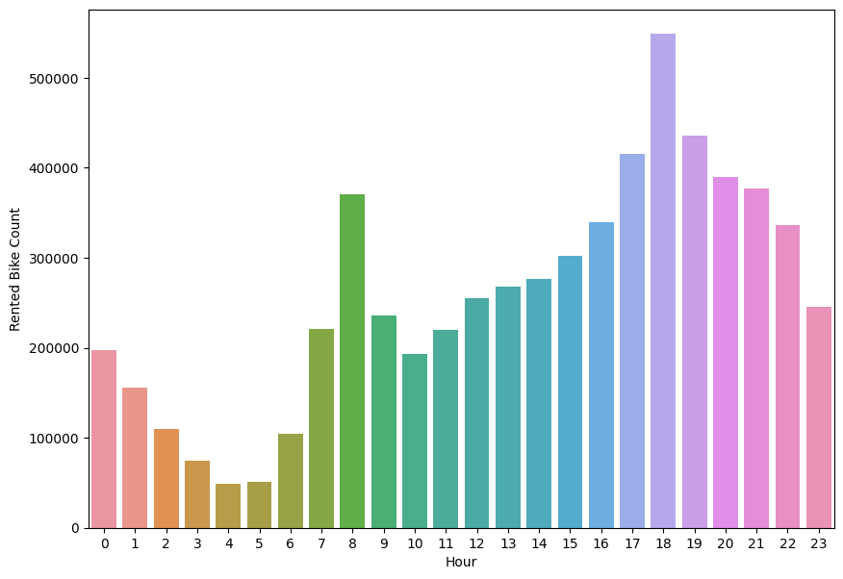
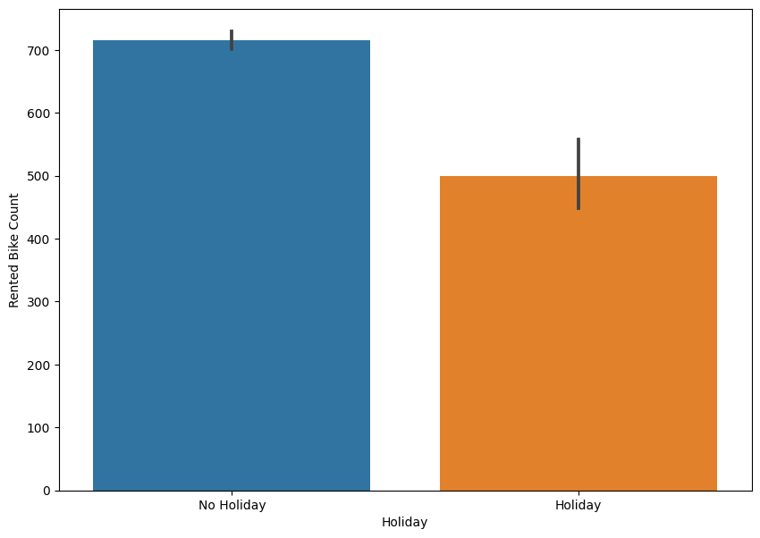
3. EDA

Slide 9
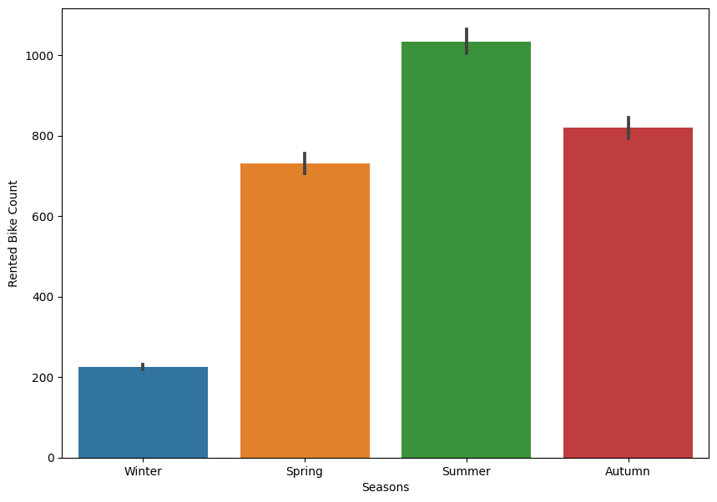
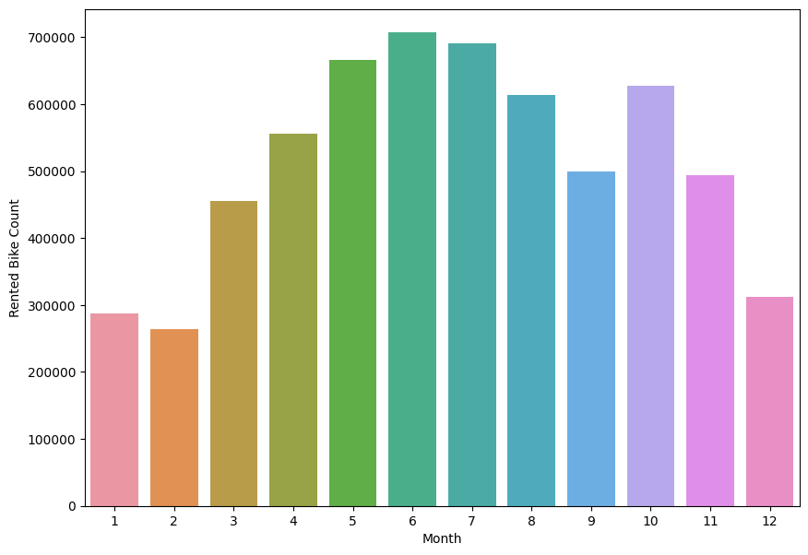
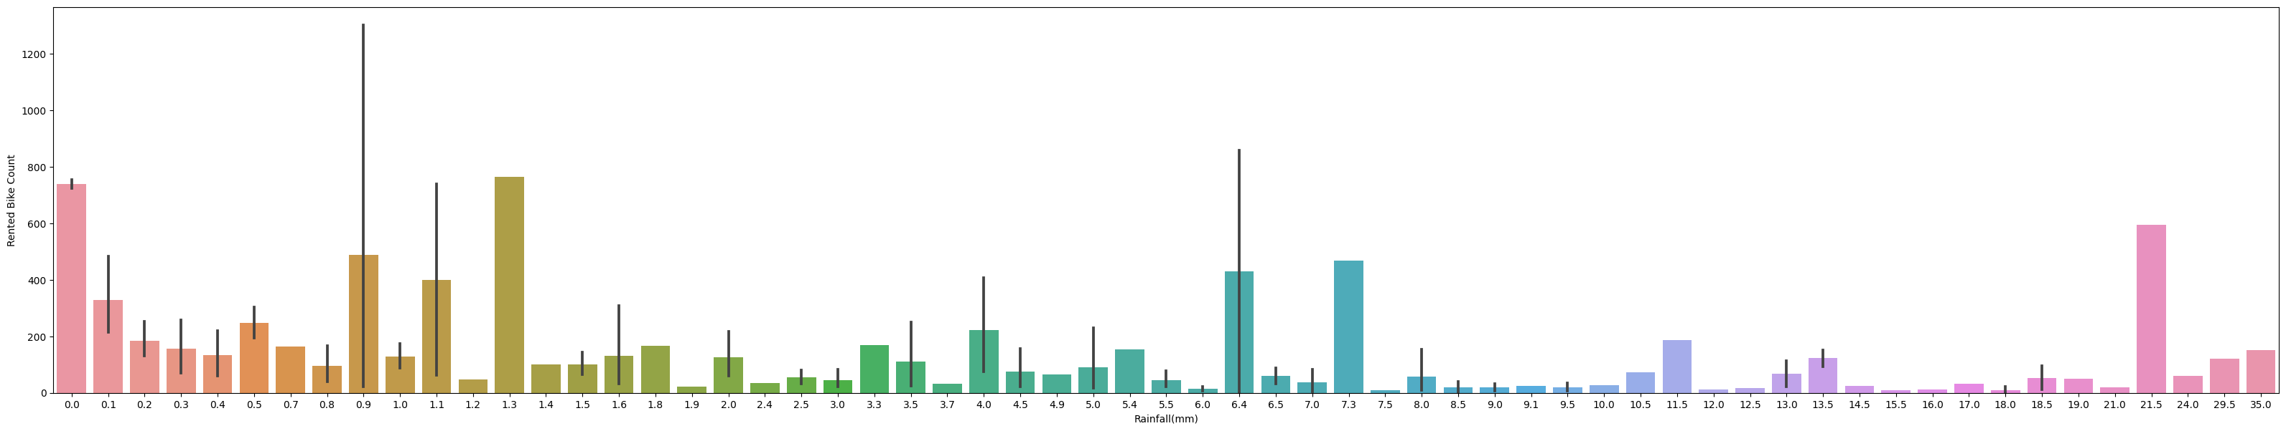
4. EDA:

Slide 10
5.Data Cleaning:
Handling Null values: In this project the first step in Data cleaning is Handling the null values. Null values can affect the accuracy and quality of our ML models, therefore it is a good practice to handle null values. In our case, fortunately there are no null values in our dataset, so we are good to go.
Handling duplicate values: Duplicate values can have adverse effects on our ML models, therefore we have to try and remove it. Luckily we don’t have any duplicate values either so we can move on to the next step in data cleaning.

Slide 11
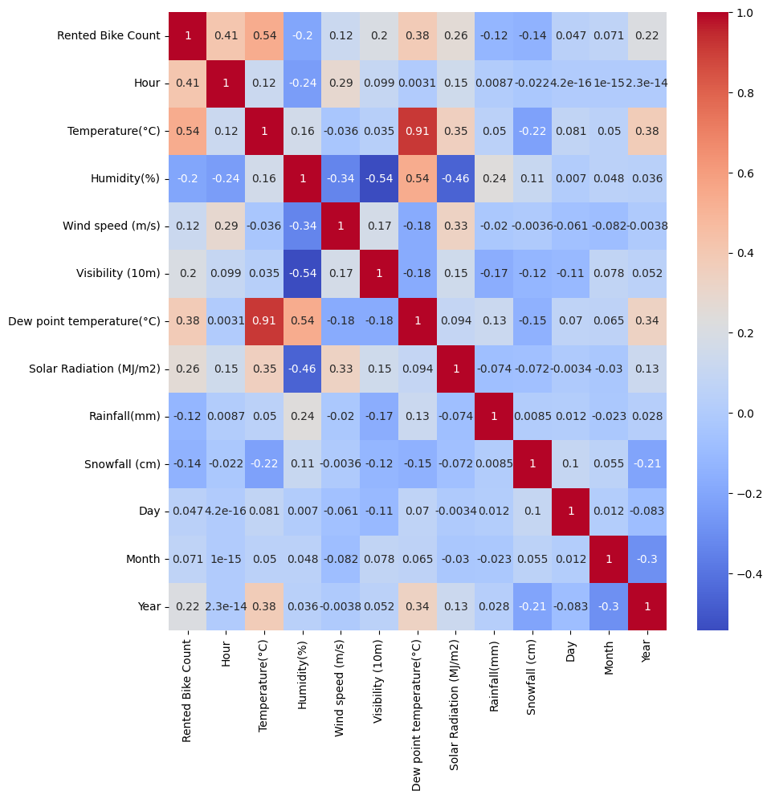
6.Heat correlation map:

Slide 12
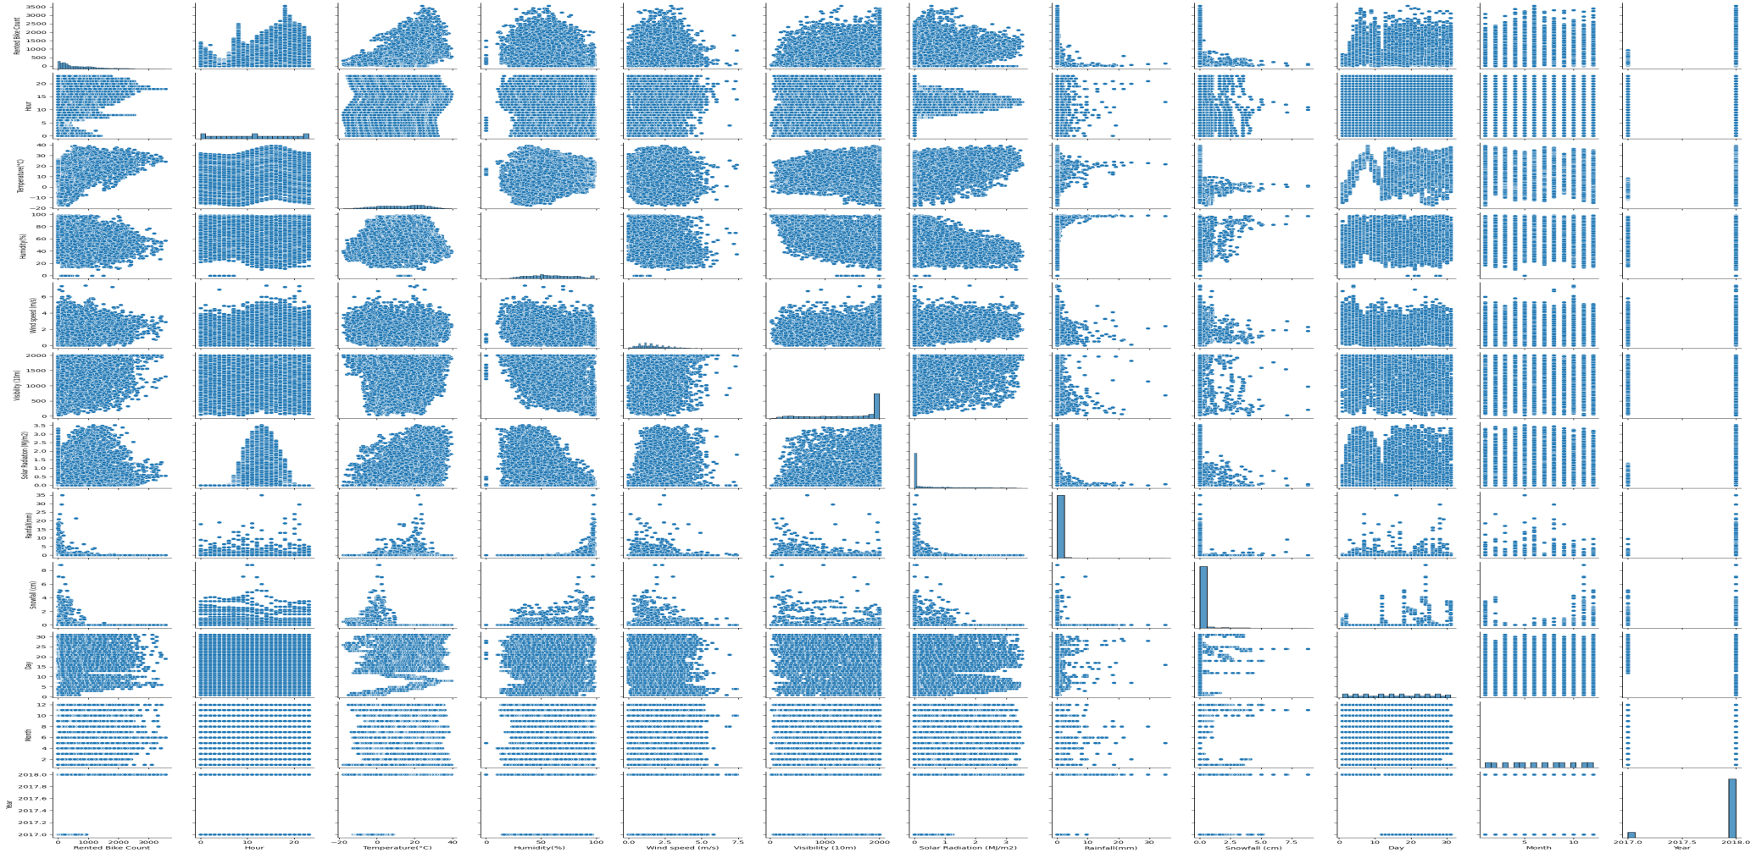
7. Pair plot:

Slide 13
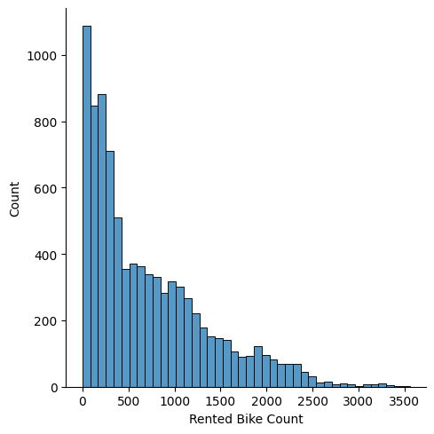
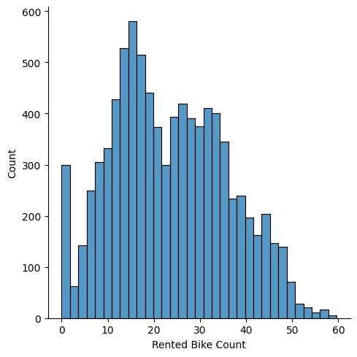
8. Pre processing of data:
Checking skewnes in data
Data splitting into train and test dataset with a ratio of 8:2
Data scaling.
After normalisation
Log transformation

Slide 14
9. Variation inflation factor:
Removing multicollinearity: Multicollinearity is when two independent variables are highly correlated to each other
I have checked for multicollinearity by using the variance inflation factor.
Hour | 3.921
Visibility(10m) | 4.710
Rainfall | 1.079
Snowfall | 1.120
Humidity(%) | 4.868
Solar Radiation(Mj/m2) | 2.246
Temperature(°C) | 3.228
Wind speed(m/s) | 4.608

Slide 15
10. Categorical encoding:
In our dataset, we have three columns that have to be converted into numerical columns and they are Season, Holiday, Functioning day.
Holiday and Functioning day is directly converted by one hot encoding. For Seasons column, I have created 4 different new columns for each season and used one hot encoding on them and deleted the original seasons column.

Slide 16
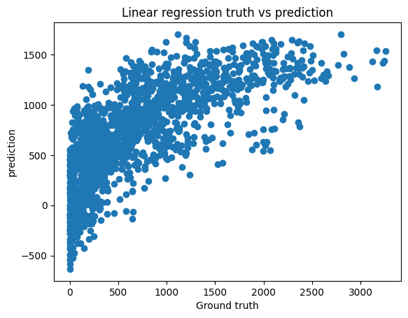
11. Model implementation :
These are two different processes in the flowchart, but for explaining purposes I’m clubbing the two into a single process.
LINEAR REGRESSION:
Evaluation Metrics:
MSE - 18894.74
RMSE - 434.678
R2 - 0.537
MAE – 330.904

Slide 17

12. Model implementation and explainability:
RIDGE REGRESSION:
Evaluation Metrics:
MSE - 86.3913
RMSE - 9.2946
R2 - 0.4531
Adj R2 - 0.4506

Slide 18

13. Model implementation and explainability:
LASSO REGRESSION:
Evaluation Metrics:
MSE - 188895.35
RMSE - 434.621
R2 - 0.537
MAE - 330.551

Slide 19
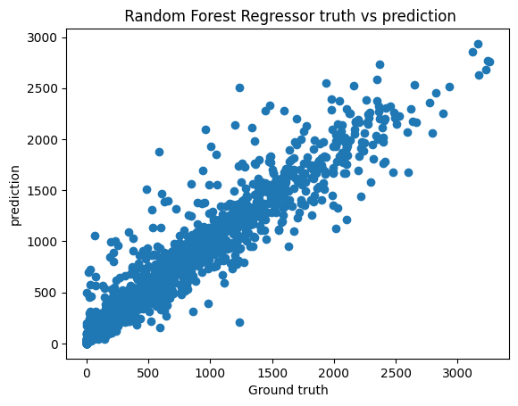
14. Model implementation and explainability:
RANDOM FOREST REGRESSION:
Evaluation Metrics:
MSE - 39943.697
RMSE - 199.859
R2 - 0.902
MAE - 119.789

Slide 20
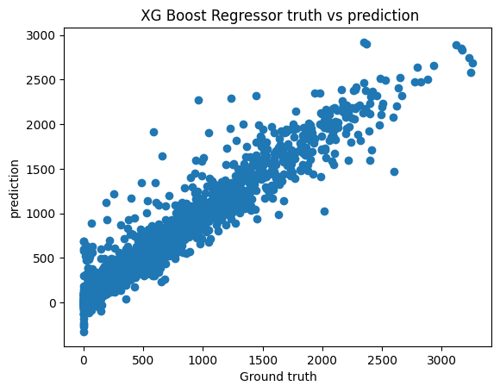
15. Model implementation and explainability:
XG boost REGRESSION:
Evaluation Metrics:
MSE - 30221.06
RMSE - 173.842
R2 - 0.926
MAE - 107.293

Slide 21
Conclusion:
Result from EDA :
Most number of bikes are rented in the Summer season and the lowest in the winter season.
Over 96% of the bikes are rented on days that are considered as No Holiday.
Most number of bikes are rented in the temperature range of 15 degrees to 30 degrees.
Most number of bikes are rented when there is no snowfall or rainfall.
Majority of the bikes are rented for a humidity percentage range of 30 to 70.
The highest number of bike rentals have been done in the 18th hour, i.e 6pm, and lowest in the 4th hour, i.e 4am.

Slide 22
Conclusion from Ml model:
Results from ML models:
XG boost Regression is the best performing model with an r2 score of 0.9263.
Support vector Regressionis the worst performing model with an r2 score of 0.221.

Slide 23

THANKYOU!!

